Slide 1
Automated Feature Extraction for High-Throughput Synchrotron Characterization
SSRL / SLAC
Alexander Ivanov, Robert Tang-Kong, Suchismita Sarker, Apurva Mehta

Slide 2
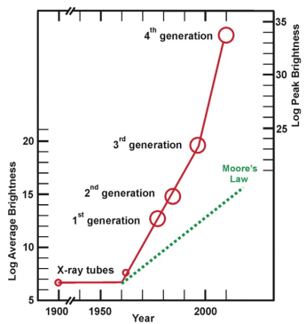
Light Sources Brighter than Ever Before
We can do more experiments, so where are the publications?
J. B. Parise and G. E. Brown, Jr. Elements, 2, 37-42 (2006)
Notes:
You all know this, preaching to the choir
Measurements vs knowledge
Rate of discovery, why?
Caveat: problems are getting more complex, need more data
End result is still lots of data that is not being analyzed
2006: 100 patterns a day
LCLS: >1E4-6 patterns per day
1

Slide 3
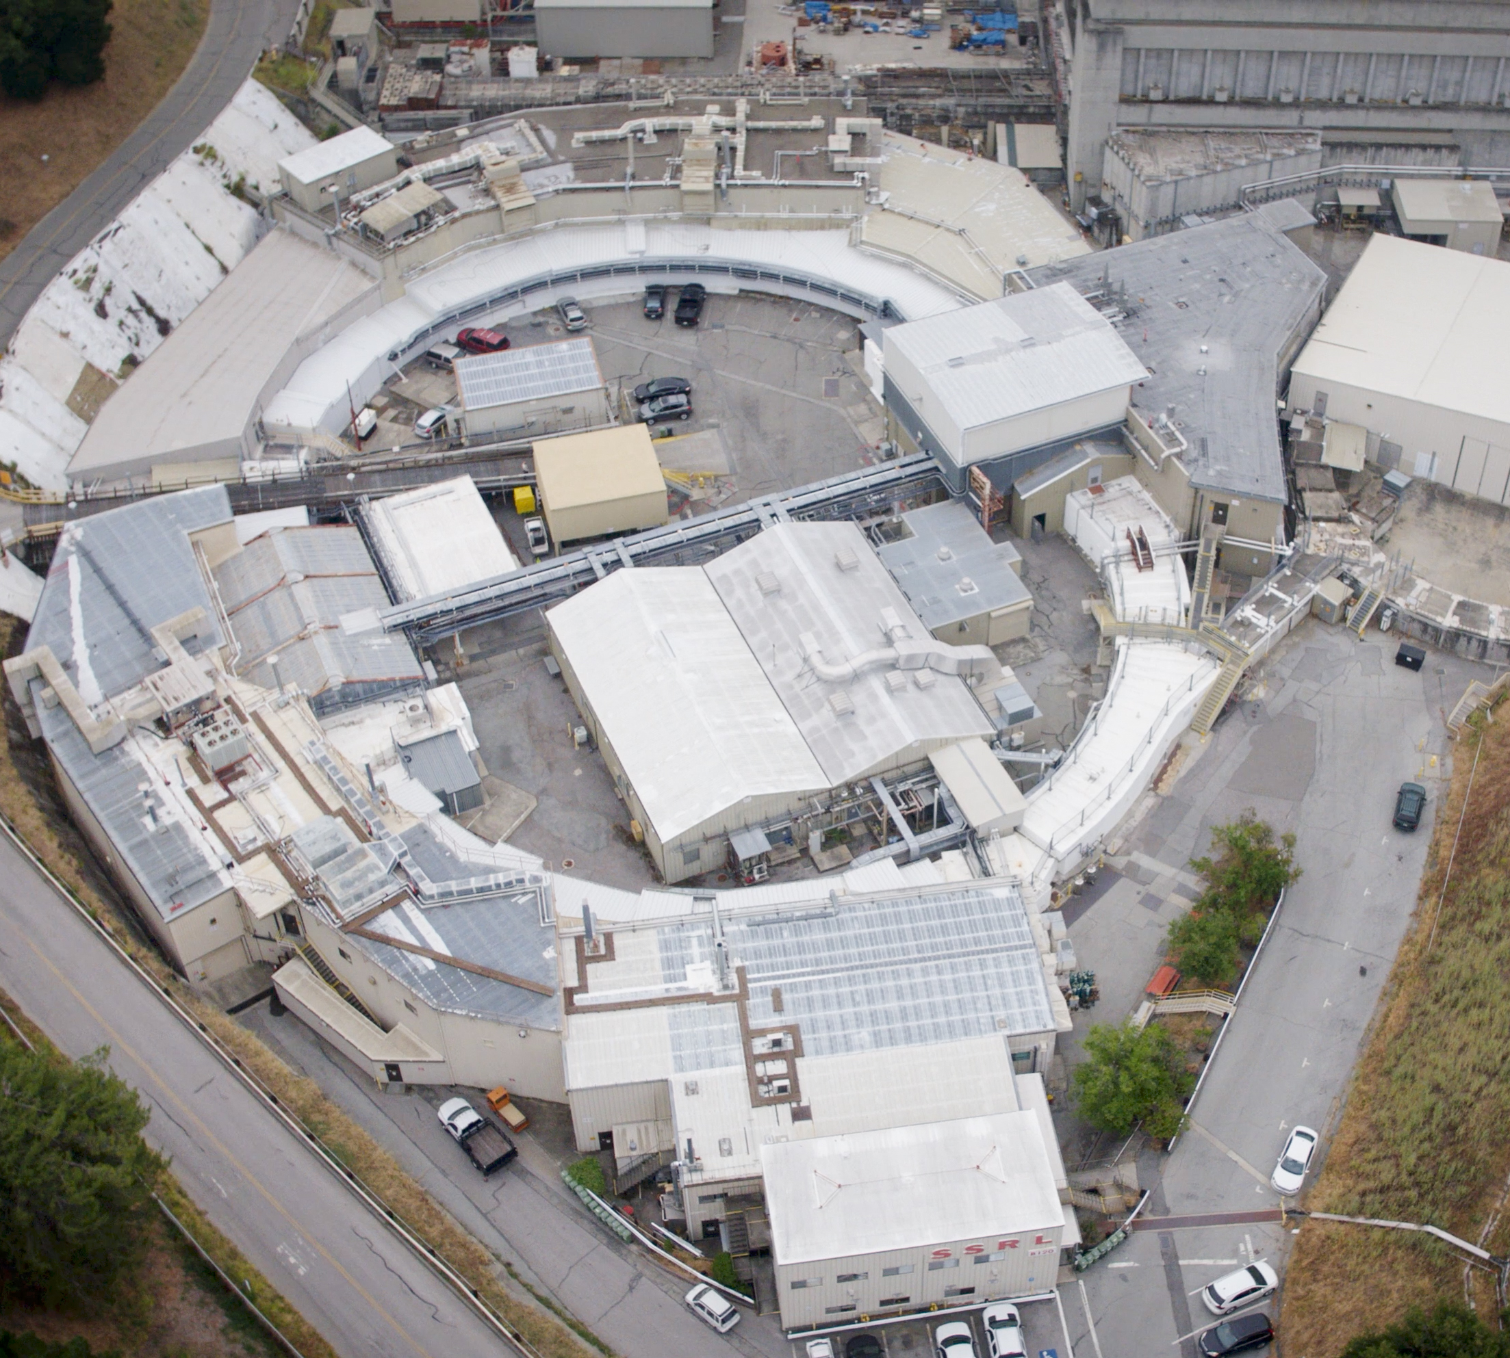
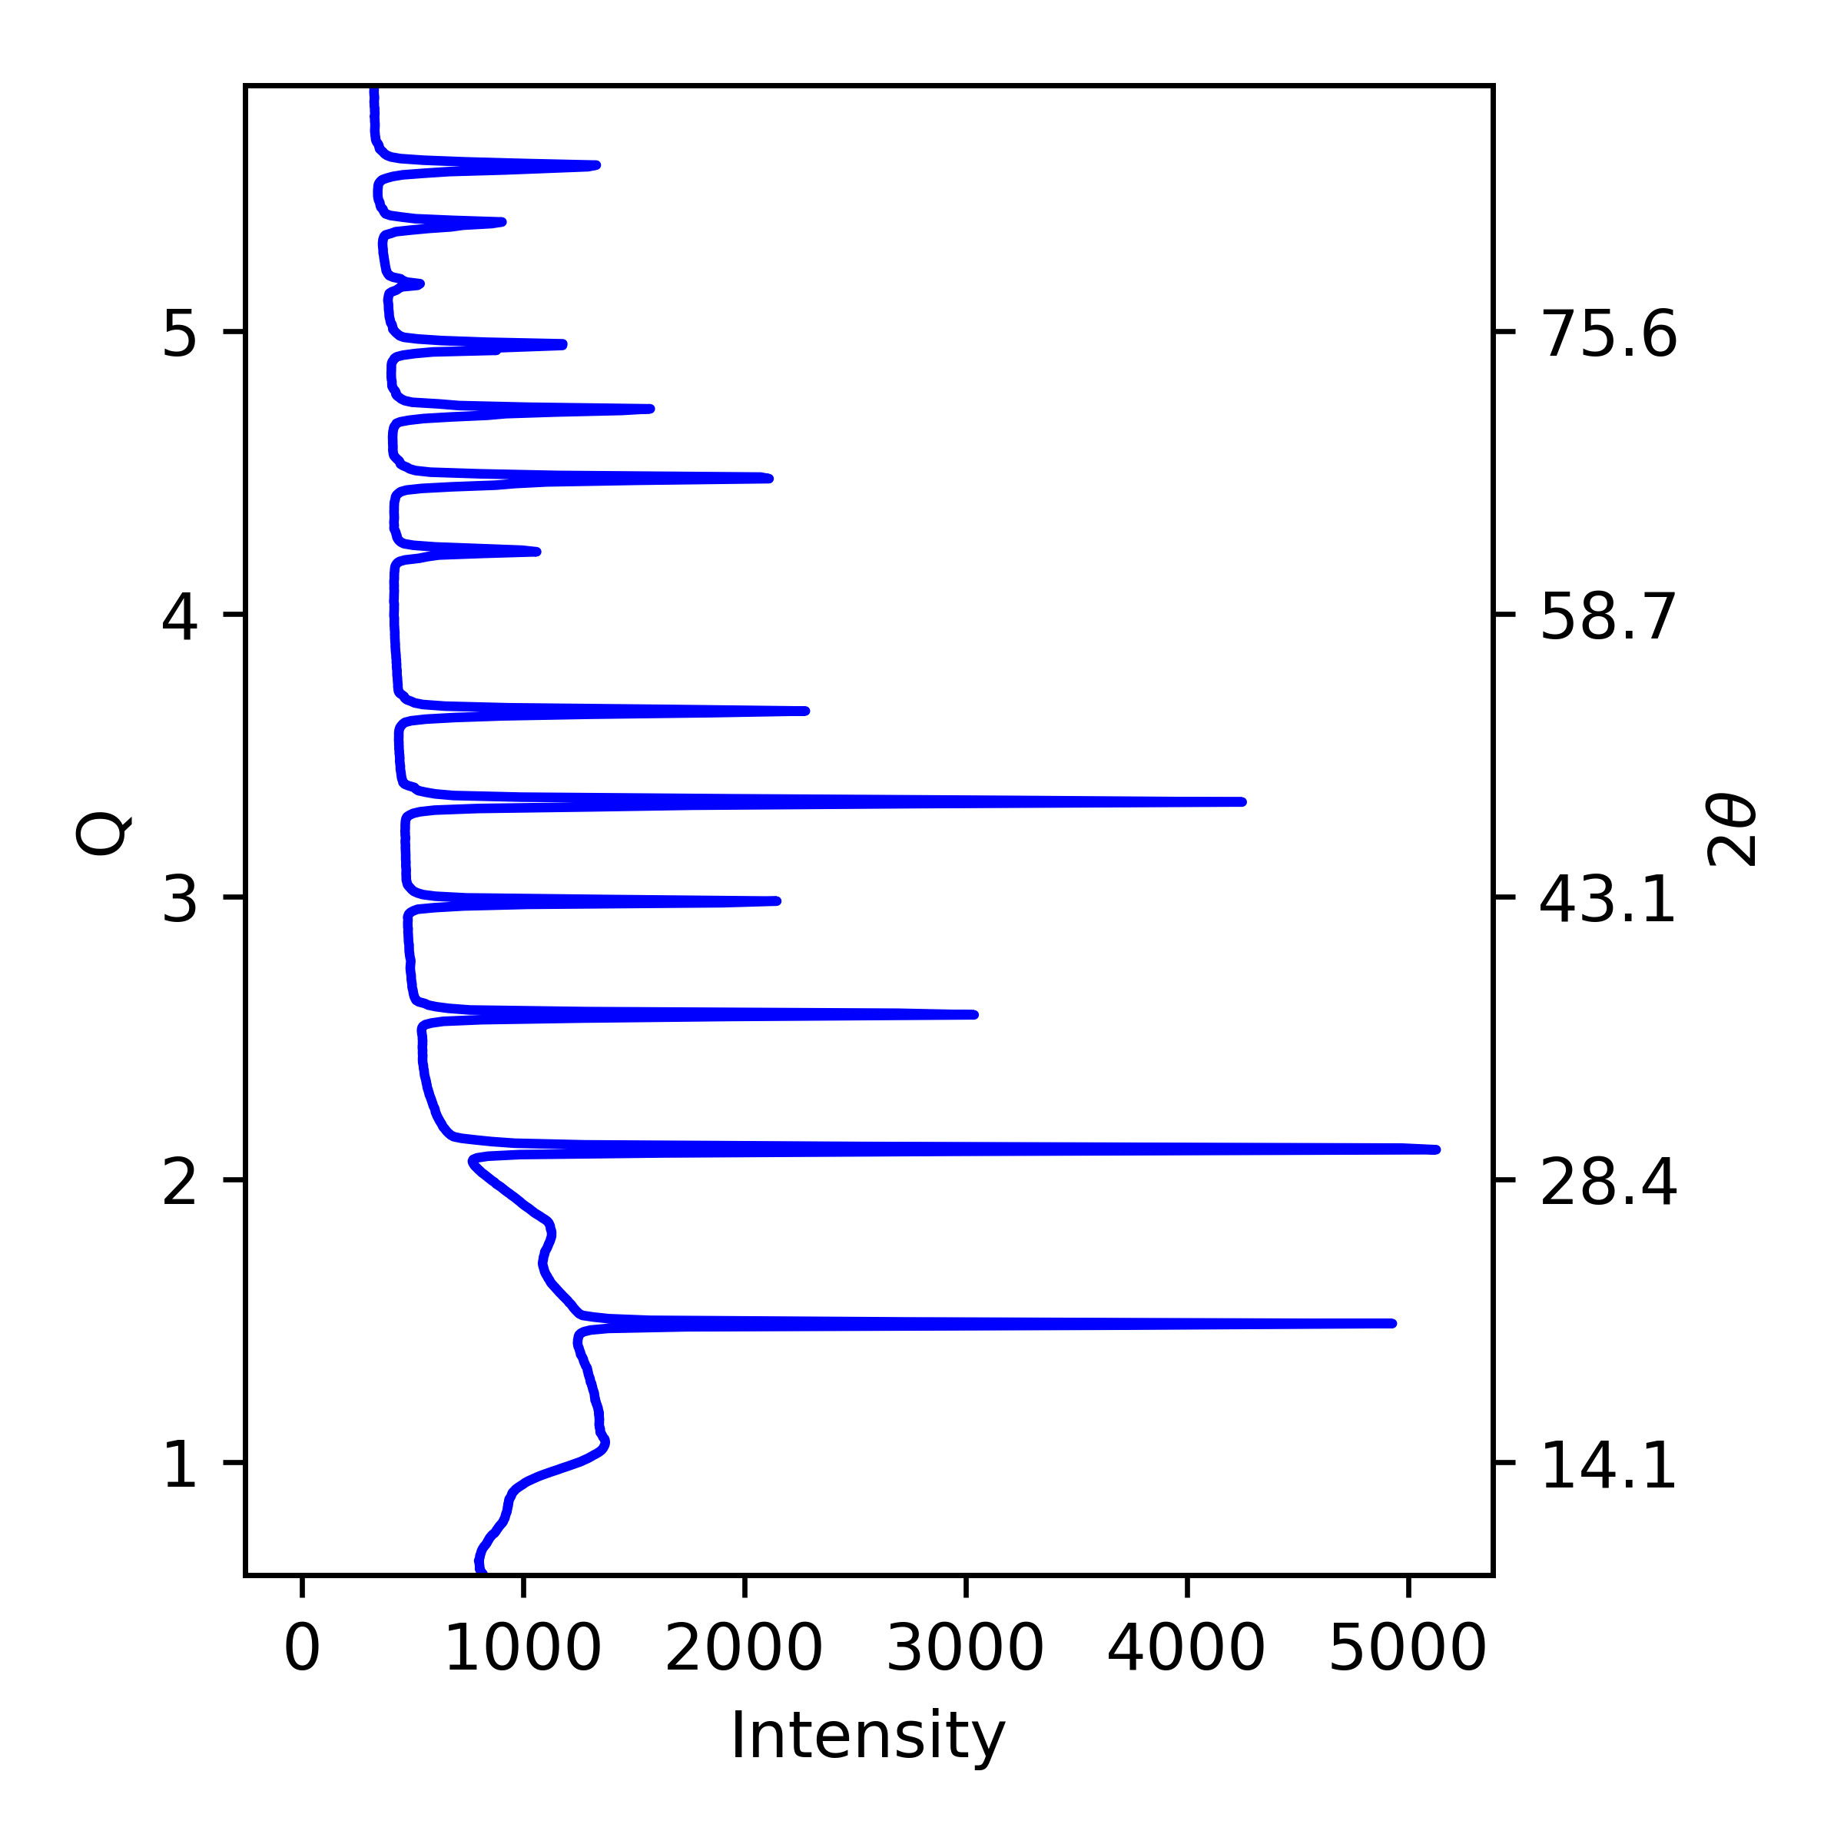
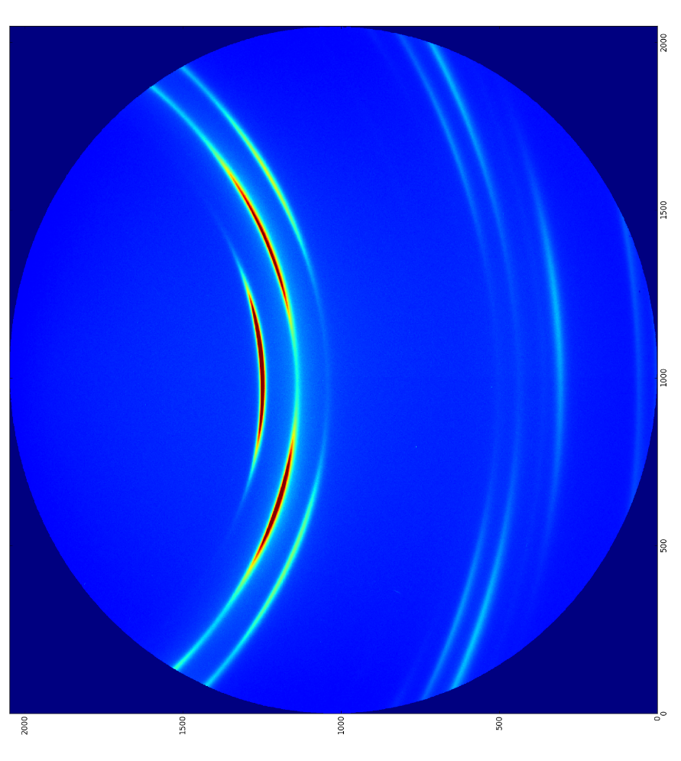
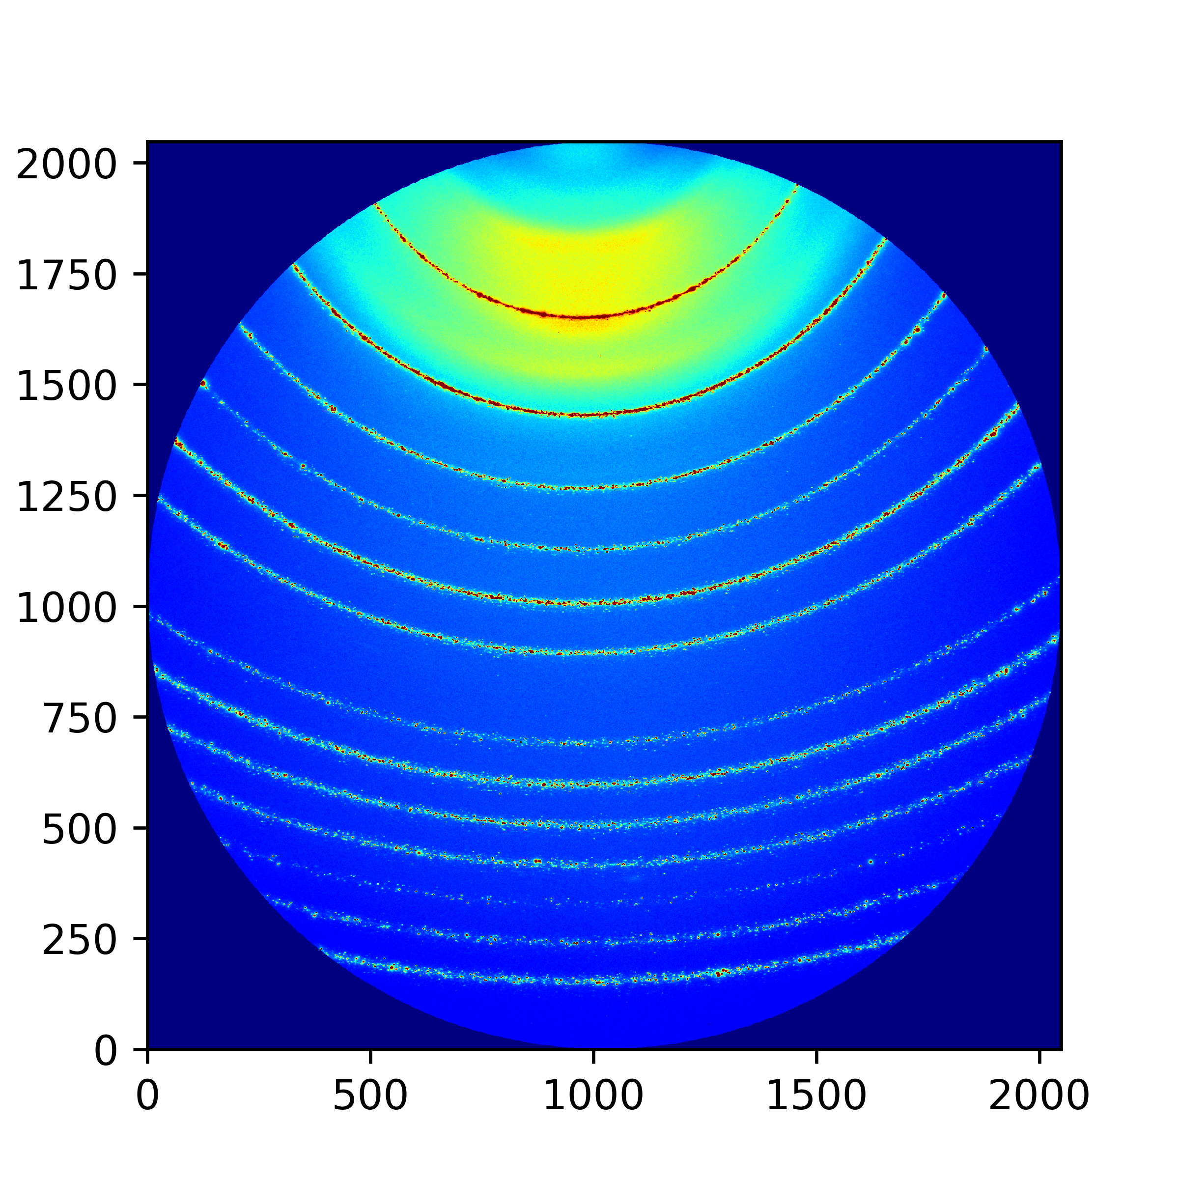
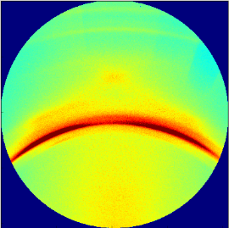
The New Bottle Neck
Measurement
Analysis
Discoveries/ Knowledge
ID | No. peaks | FWHM | Noise
… | … | … | …
1 | 2 | 0.5 | 0.07
2 | 4 | 0.3 | 0.50
… | … | … | …
1
Notes:
1

Slide 4
The New Bottle Neck
Measurement
Analysis
Discoveries/ Knowledge
ID | No. peaks | FWHM | Noise
… | … | … | …
1 | 2 | 0.5 | 0.07
2 | 4 | 0.3 | 0.50
… | … | … | …
1
Notes:
1

Slide 5
The New Bottle Neck
Measurement
Analysis
Discoveries/ Knowledge
ID | No. peaks | FWHM | Noise
… | … | … | …
1 | 2 | 0.5 | 0.07
2 | 4 | 0.3 | 0.50
… | … | … | …
1
Notes:
1

Slide 6
The New Bottle Neck
Measurement
Analysis
Discoveries/ Knowledge
ID | No. peaks | FWHM | Noise
… | … | … | …
1 | 2 | 0.5 | 0.07
2 | 4 | 0.3 | 0.50
… | … | … | …
How can we process all of this data?
1
Notes:
1

Slide 7
The New Bottle Neck
Measurement
Analysis
Discoveries/ Knowledge
ID | No. peaks | FWHM | Noise
… | … | … | …
1 | 2 | 0.5 | 0.07
2 | 4 | 0.3 | 0.50
… | … | … | …
How can we process all of this data?… It depends
1
It depends on the data and what you are tying to find. We are interested in metallic glasses and for us automated clustering would remove the bottle neck.
Notes:
1

Slide 8
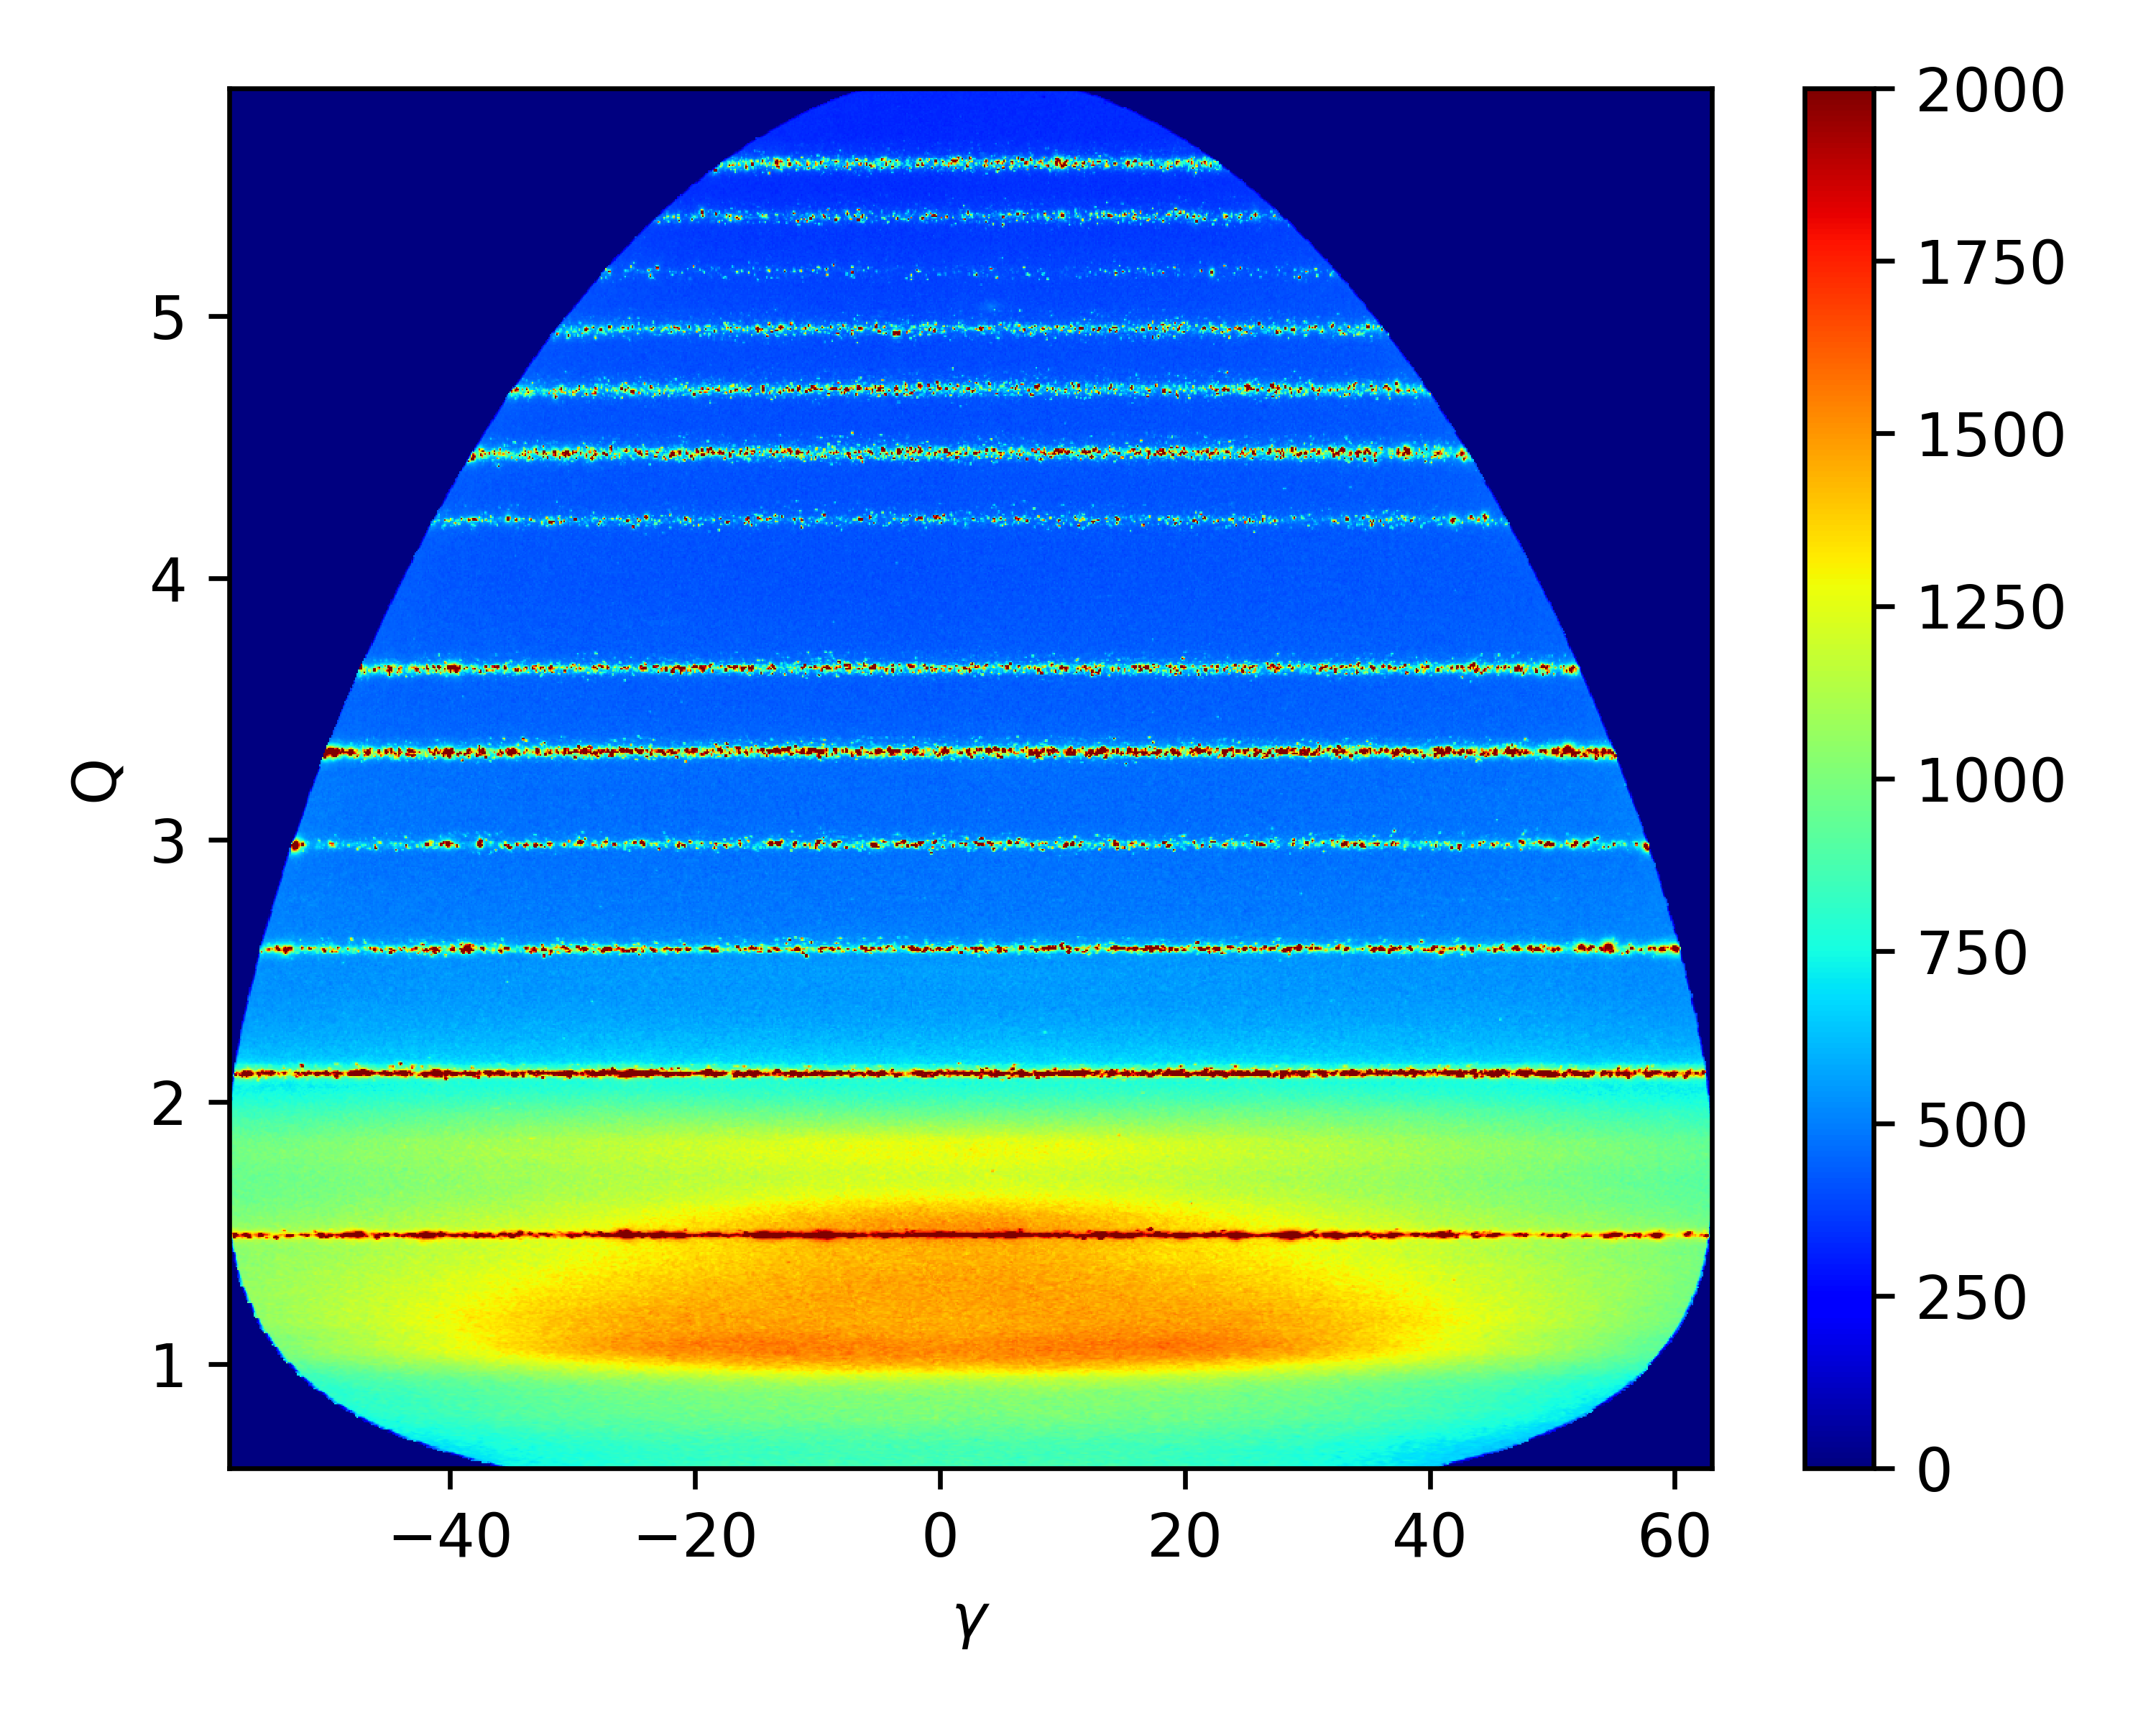
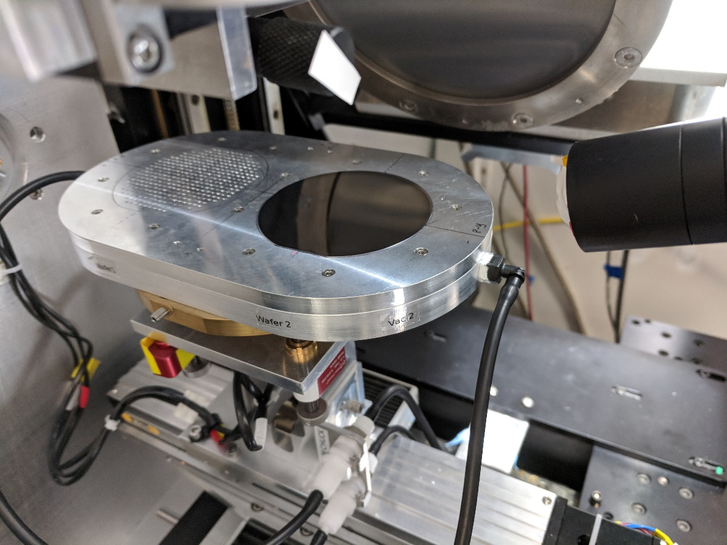
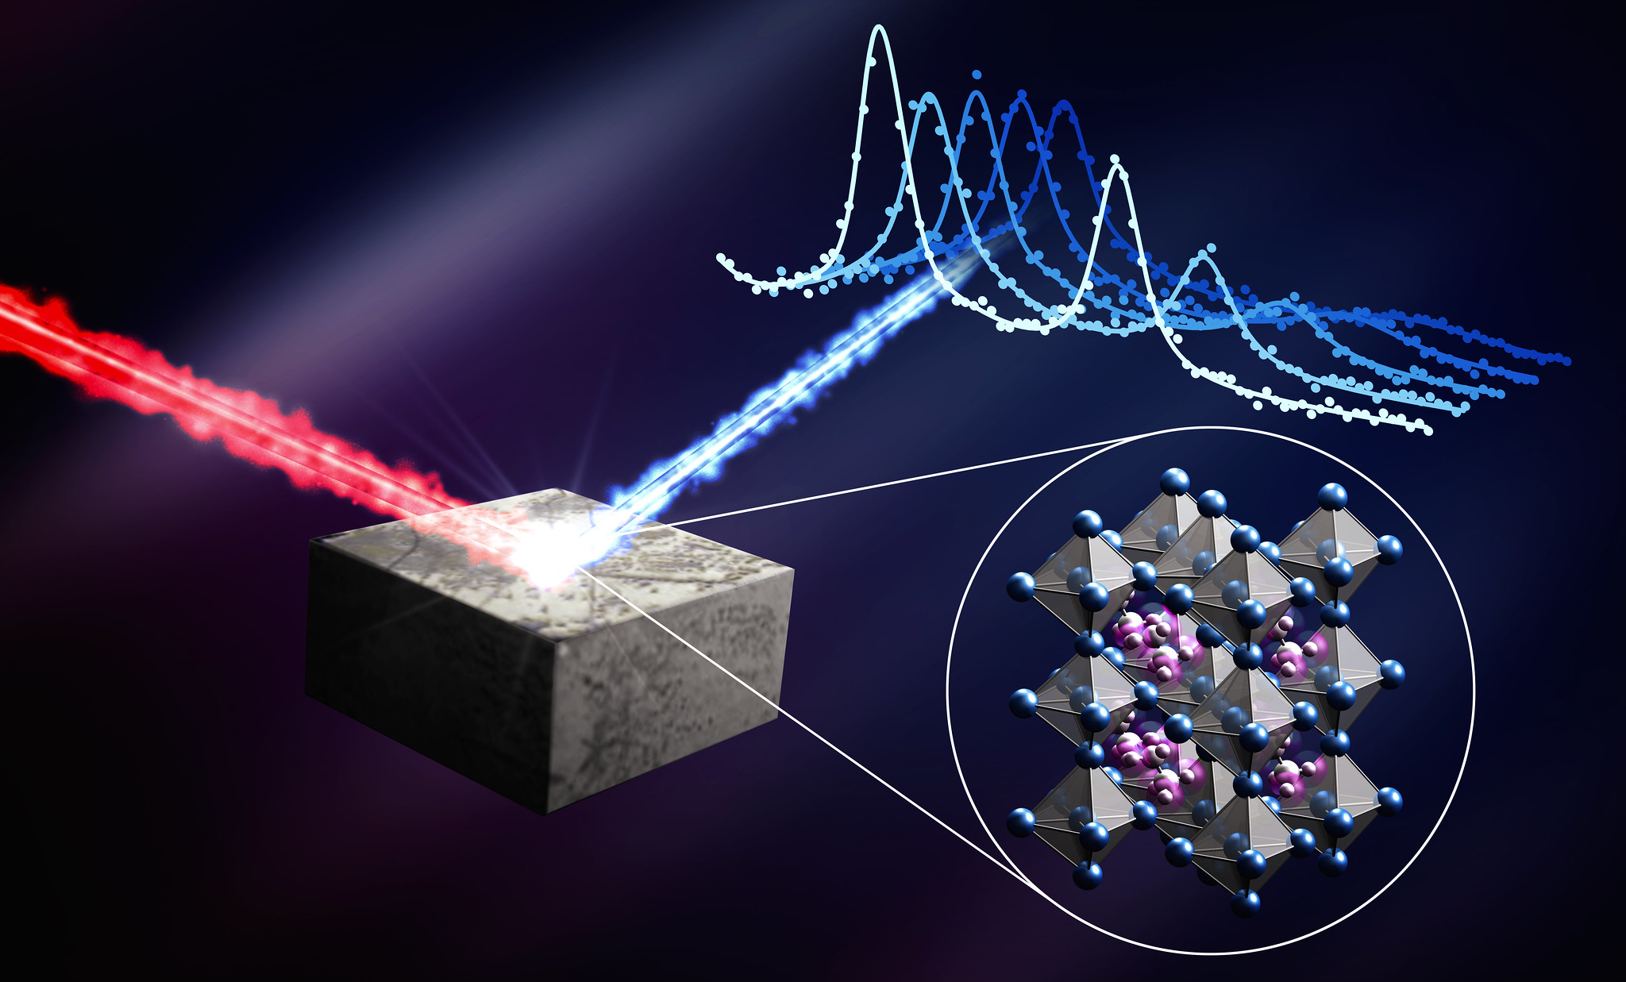
Metallic Glasses
Data Collection
Preprocessing
1
Notes:
1

Slide 9
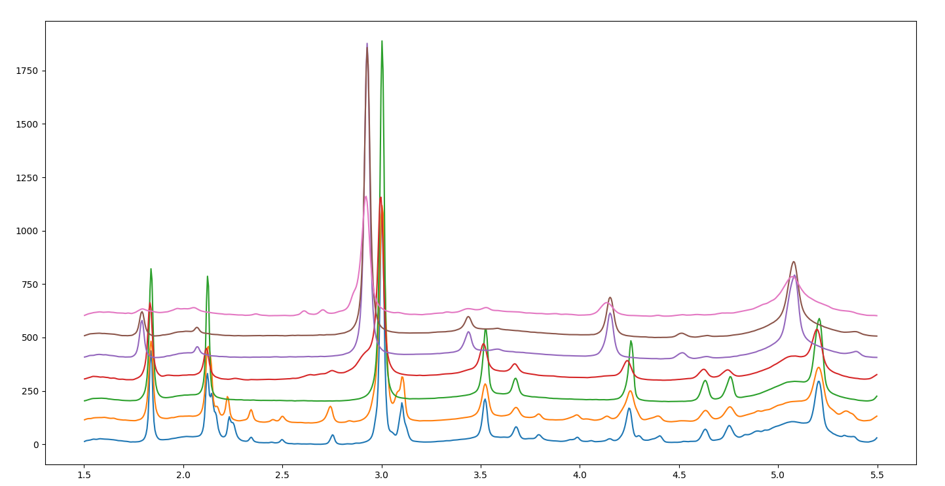
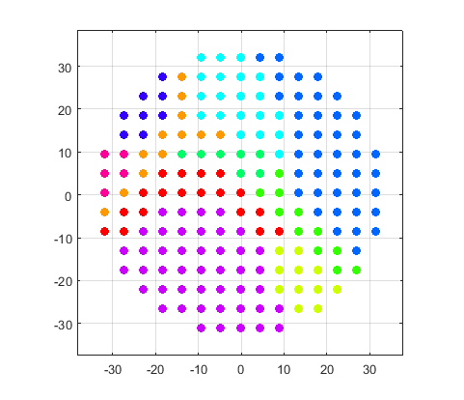
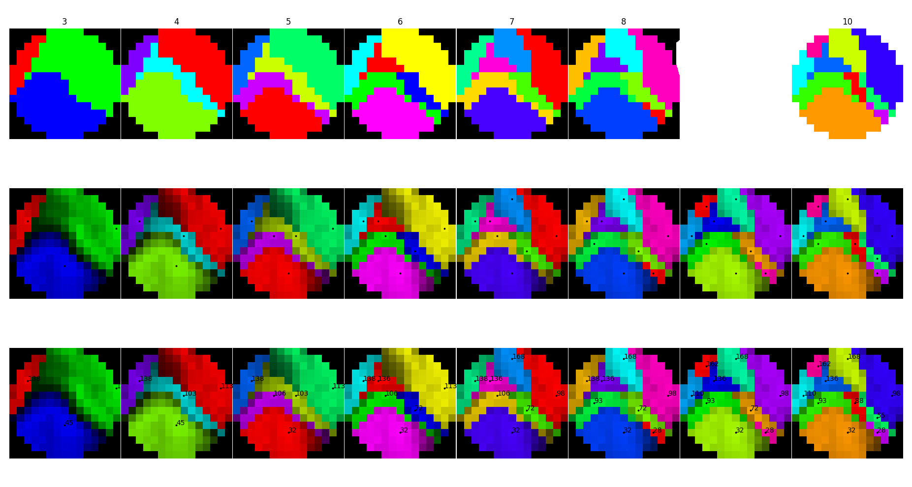
Metallic Glasses
Data Collection
Preprocessing
Clustering
1
Notes:
1

Slide 10
Metallic Glasses
Data Collection
Preprocessing
Clustering
1
Notes:
1

Slide 11
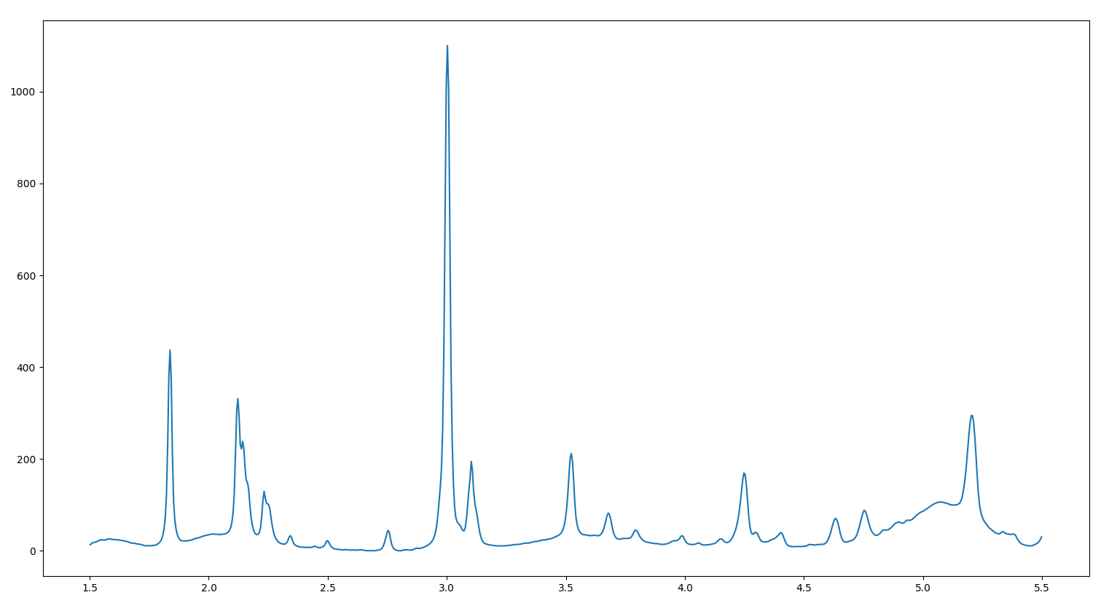
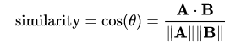
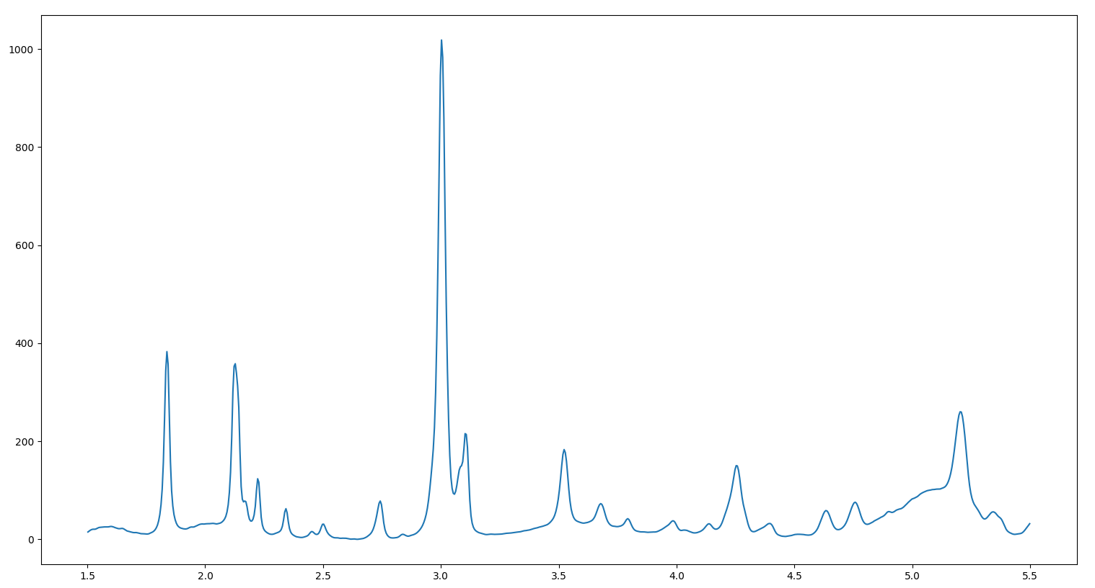
Cosine Based Clustering
Vectorize
= 97%
1
Notes:
1

Slide 12
Cosine Based Clustering
Vectorize
= 97%
5 | 8 | 11 | 7 | 4 | 0 | ...
= A
Hierarchical
Clustering
9 | 5 | 2 | 3 | 8 | 12 | ...
= B
1
Notes:
1

Slide 13
Cosine Based Clustering
Cosine Similarity Clustering
True Clustering
1
Notes:
1

Slide 14
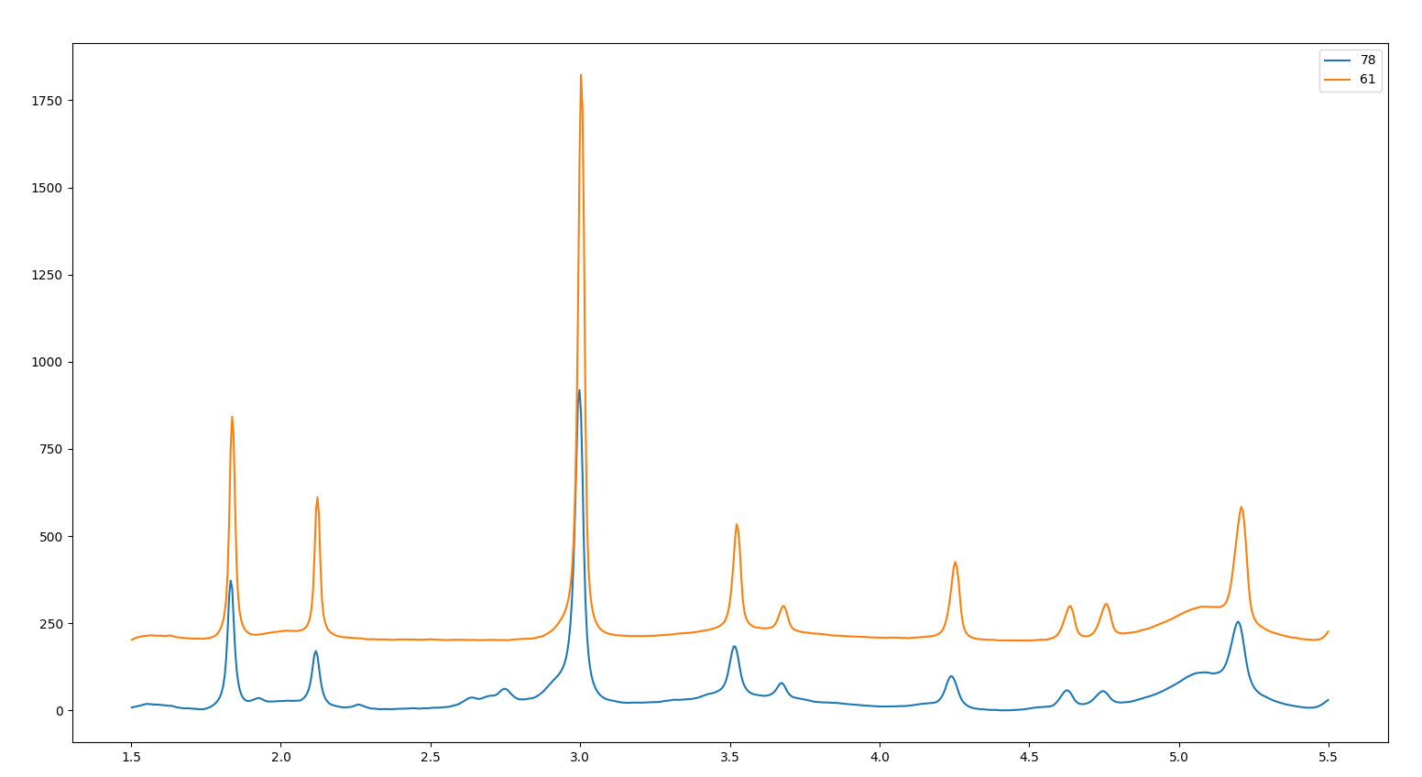
Why Cosine Similarity is Broken
92% Similar
1
Notes:
1

Slide 15
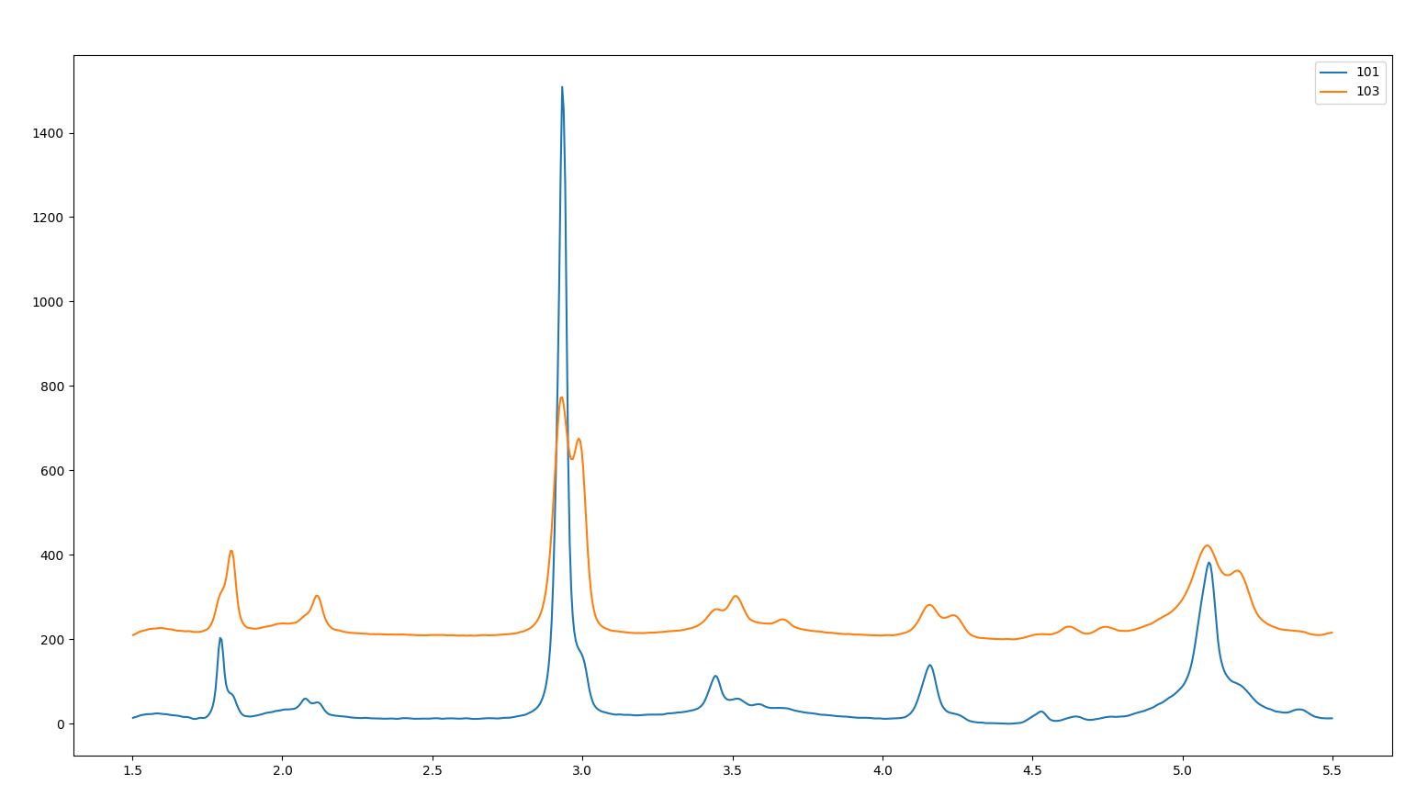
Why Cosine Similarity is Broken
85% Similar
1
Notes:
1

Slide 16
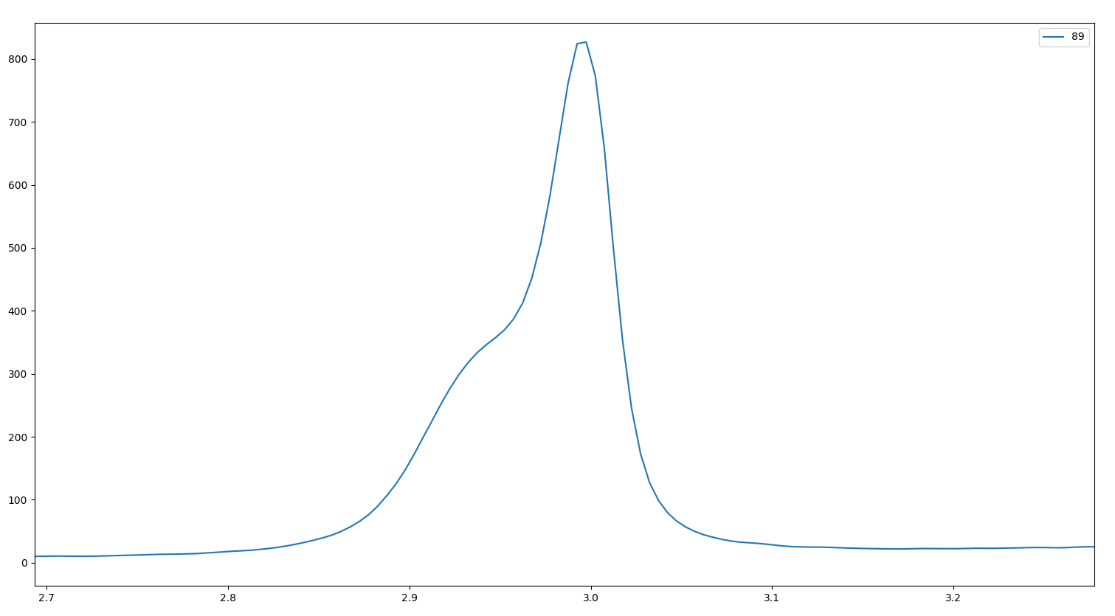
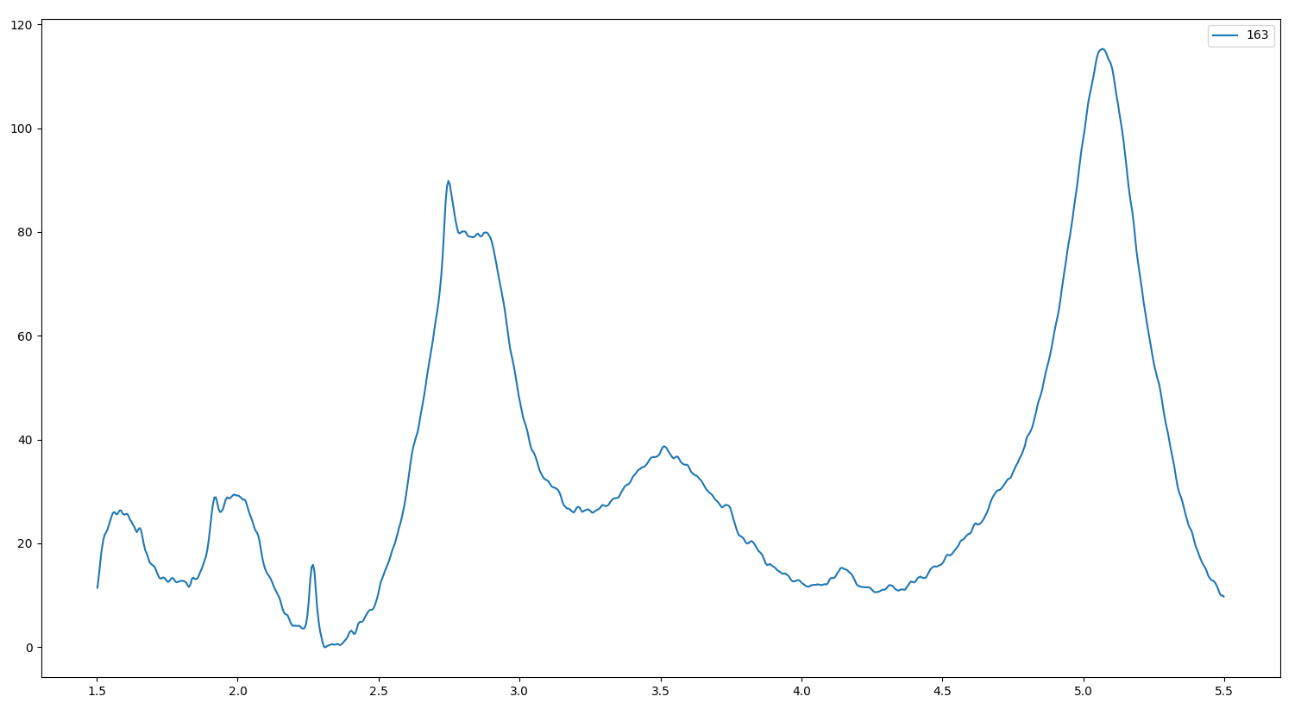
Challenges of Detecting Peaks
Overlapping Peaks
Noisy Data
1
Notes:
1

Slide 17
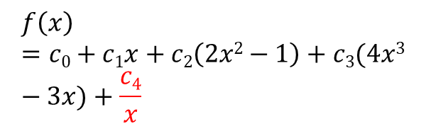
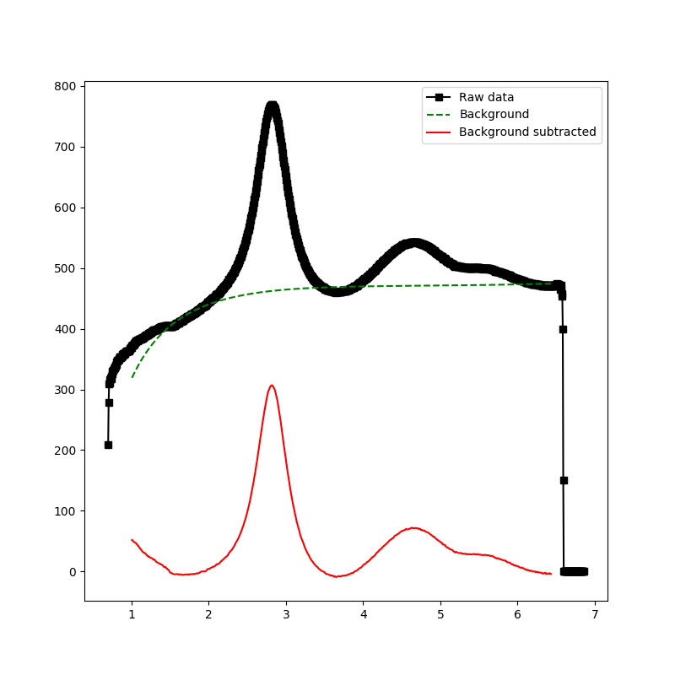
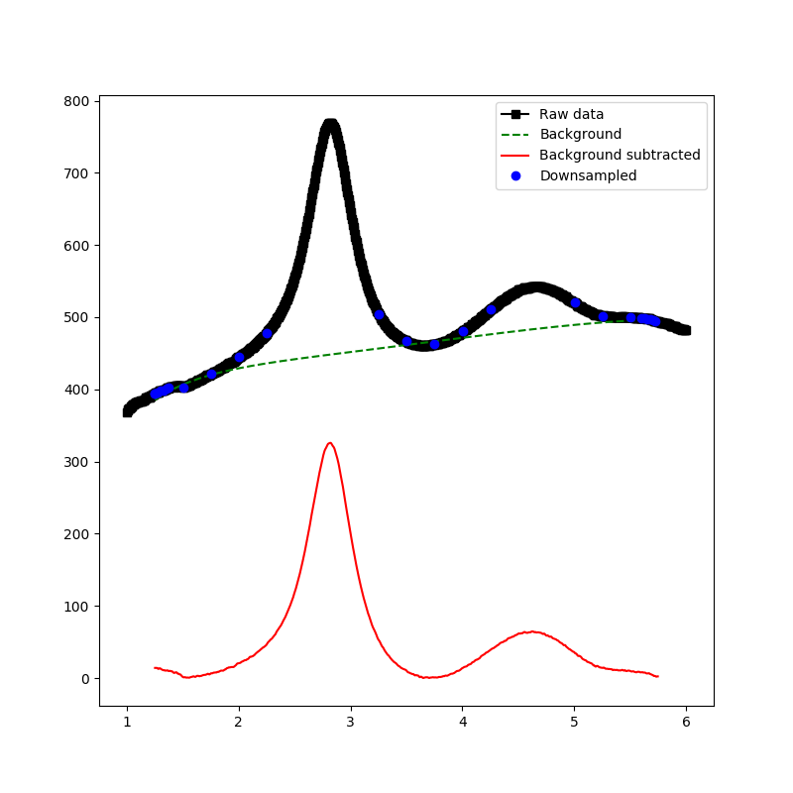
Background Subtraction
Modified Chebyshev Polynomial
Take points below median
Emphasize edge points to pin edges of function
1
Notes:
1

Slide 18
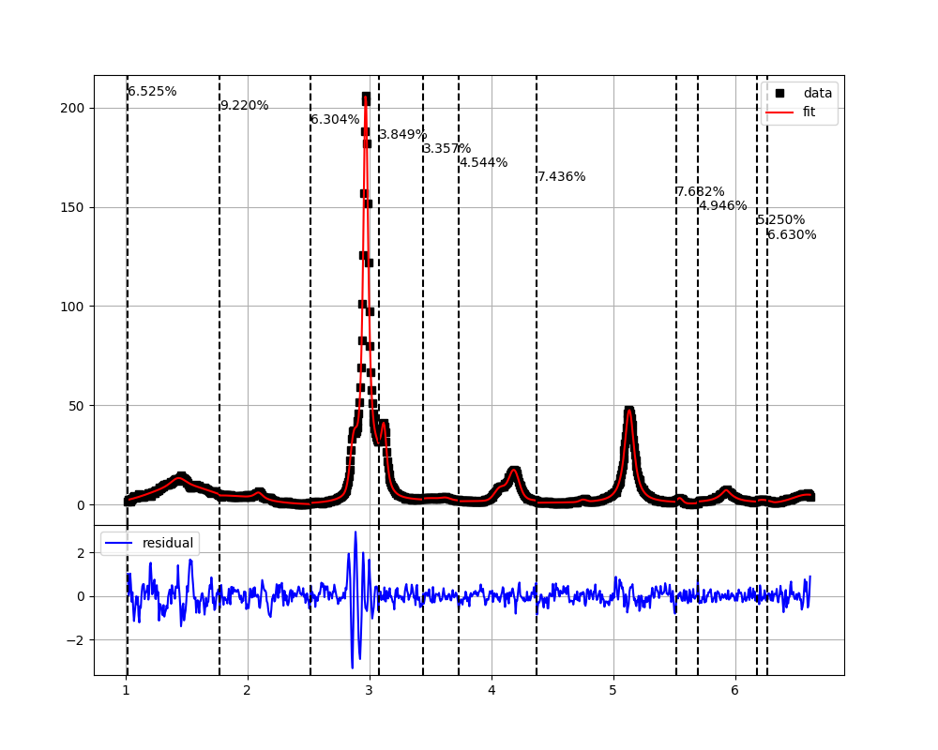
Bayesian Block Analysis
Bayesian Block Analysis for Peak Detection
Block data into statistically similar regions.
Hill climbing on blocks
Produce peak regions for
peak fitting
1
Notes:
1

Slide 19
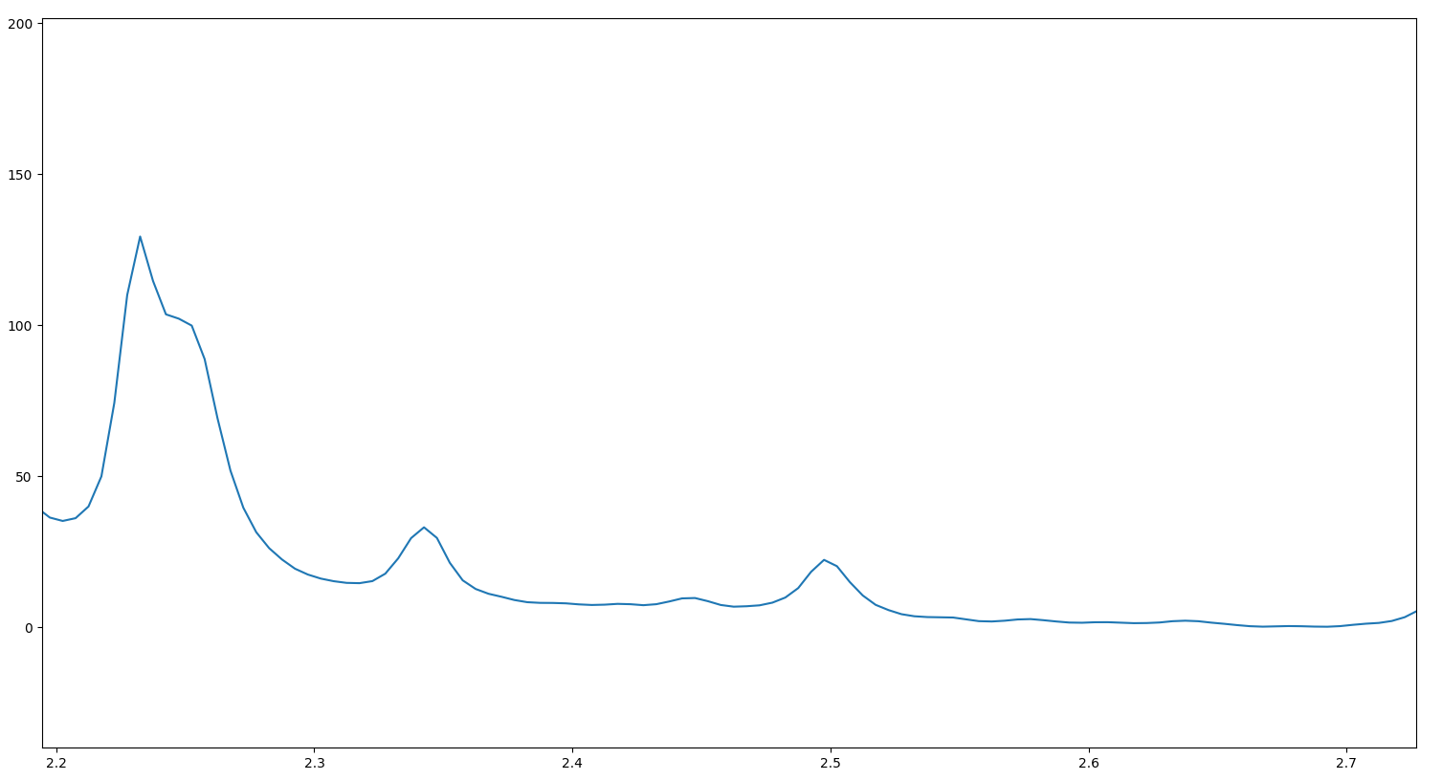
Bayesian Block Analysis
1
Notes:
1

Slide 20
Bayesian Block Analysis
1
Notes:
1

Slide 21
Bayesian Block Analysis
1
Notes:
1

Slide 22
Bayesian Block Analysis
1
Notes:
1

Slide 23
Bayesian Block Analysis
1
Notes:
1

Slide 24
Bayesian Block Analysis
Block 1
Block 2
Block 3
1
Notes:
1

Slide 25
Bayesian Block Analysis
What do we do about this?
Block 1
Block 2
Block 3
1
Notes:
1

Slide 26
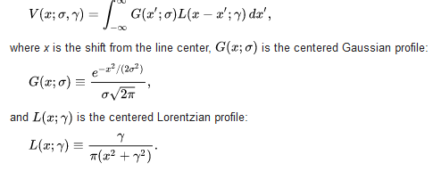
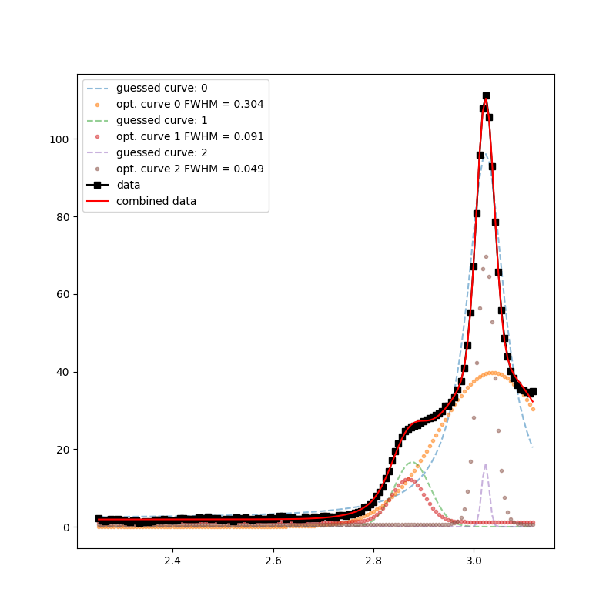
Peak Fitting
Voight profile
Fit fixed number of curves
Place curve at peak in data
Subtract curve to get new data
Repeat until all curves are placed
Optimize all curves together on original data

Slide 27
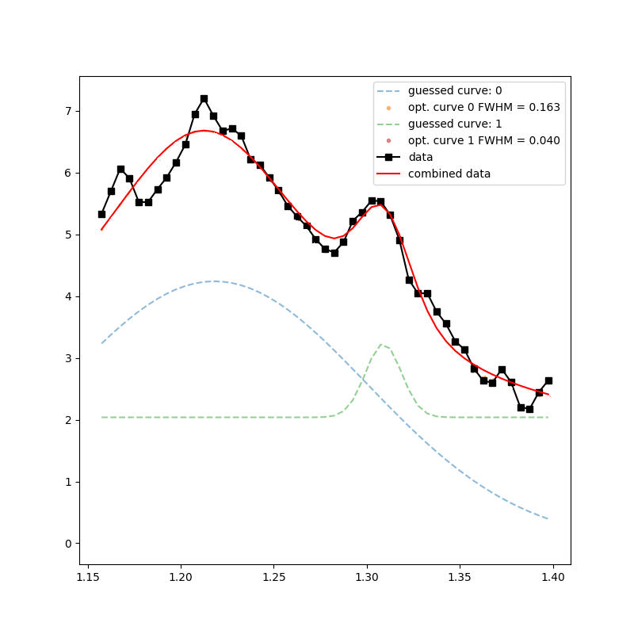
Peak Fitting
1
Notes:
1

Slide 28
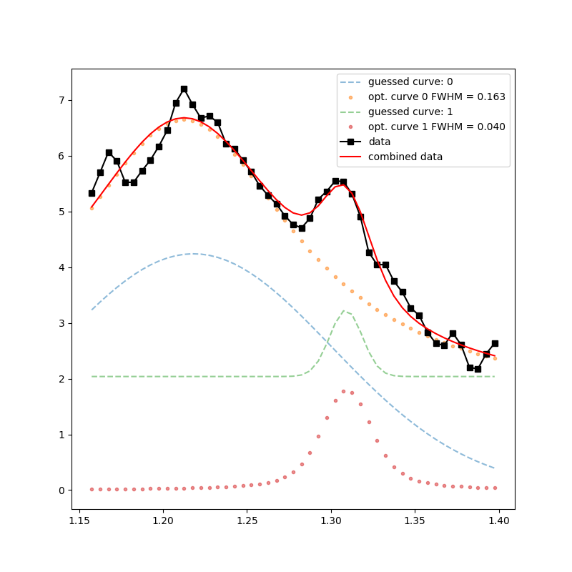
Peak Fitting
1
Notes:
1

Slide 29
Results
Does it work?
1
Notes:
1

Slide 30
Results
Does it work?
Sometimes…
1
Notes:
1

Slide 31
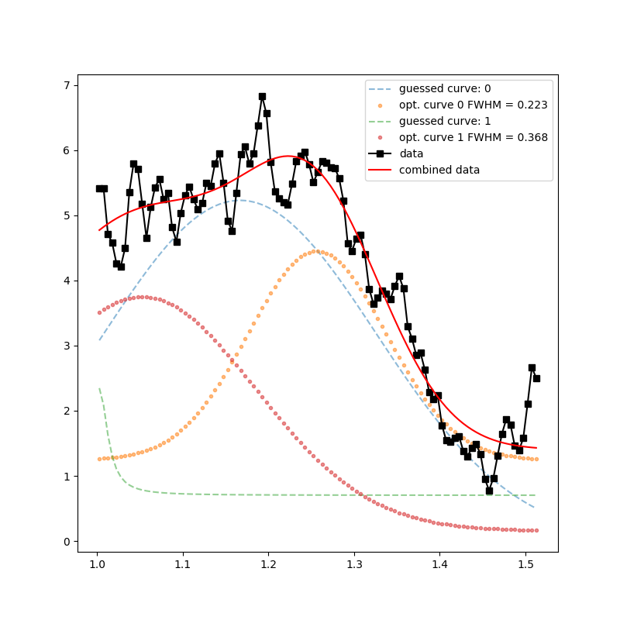
Results
1
Notes:
1

Slide 32
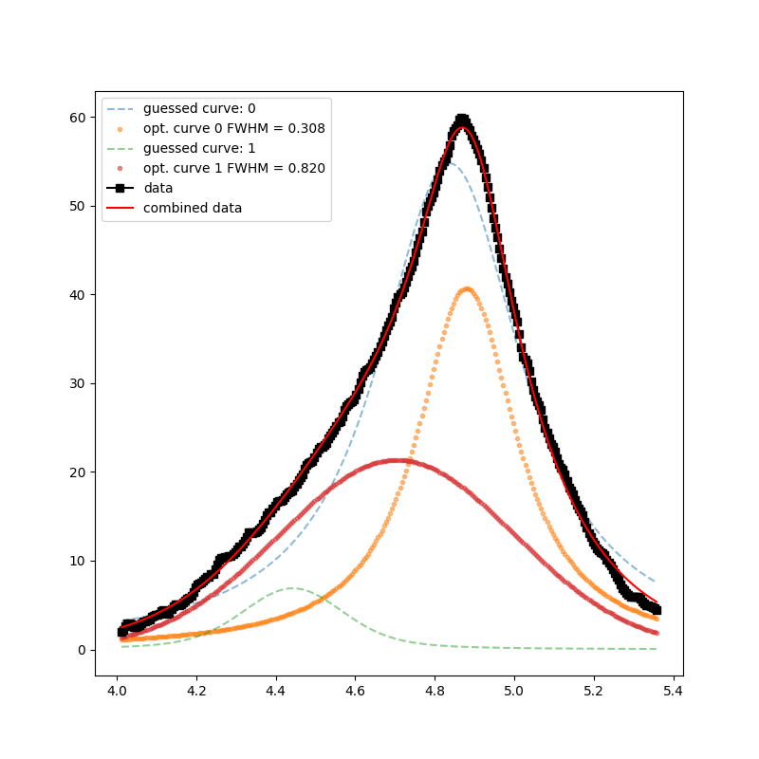
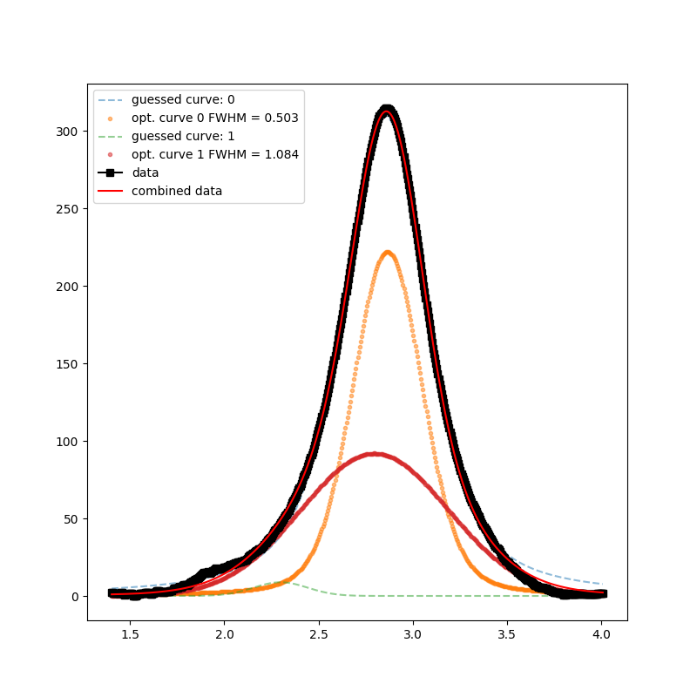
Results
1
Notes:
1

Slide 33
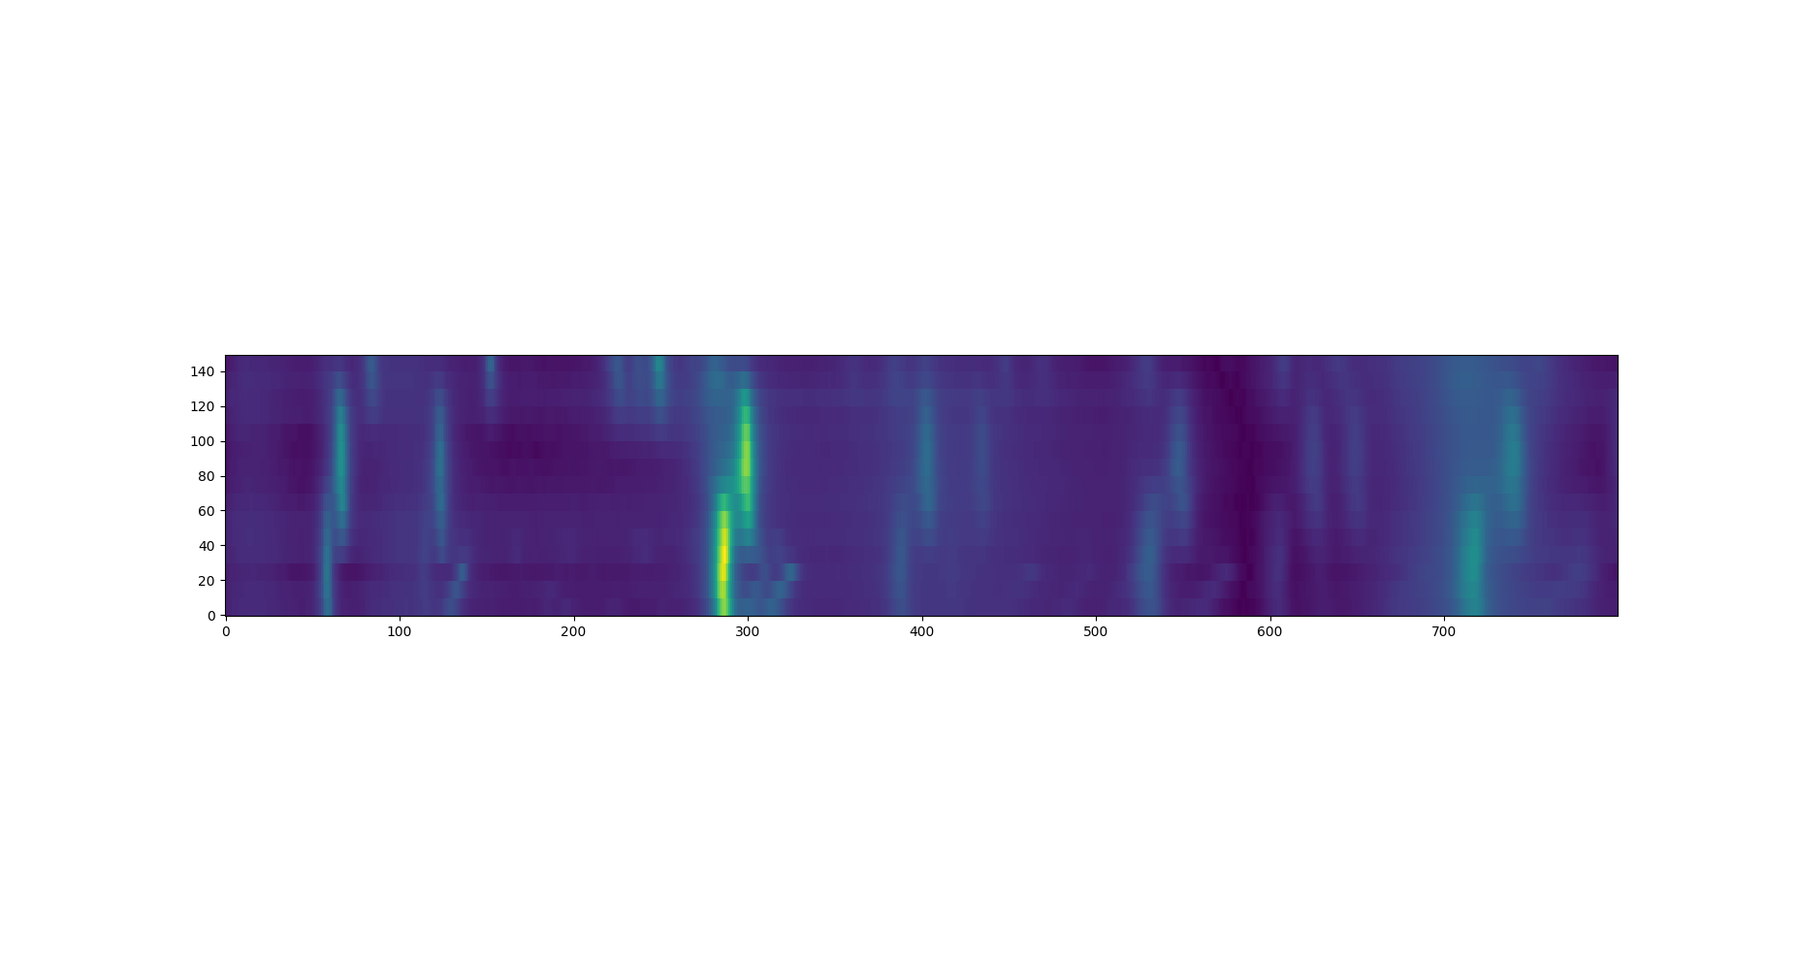
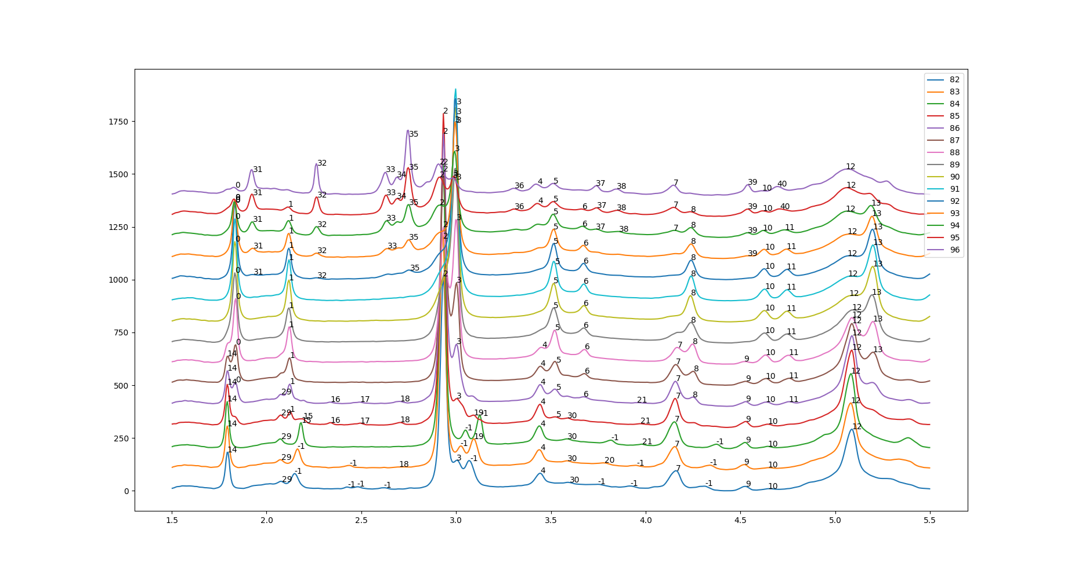
Clustering
Clustering Peaks

Slide 34
Clustering
Clustering Peaks
Extract Peak Labels

Slide 35
Clustering
Reduce Diffraction Patterns
Vector of unique peaks
0 if peak not present
Intensity of peak if present
Cluster based on reduced vectors

Slide 36
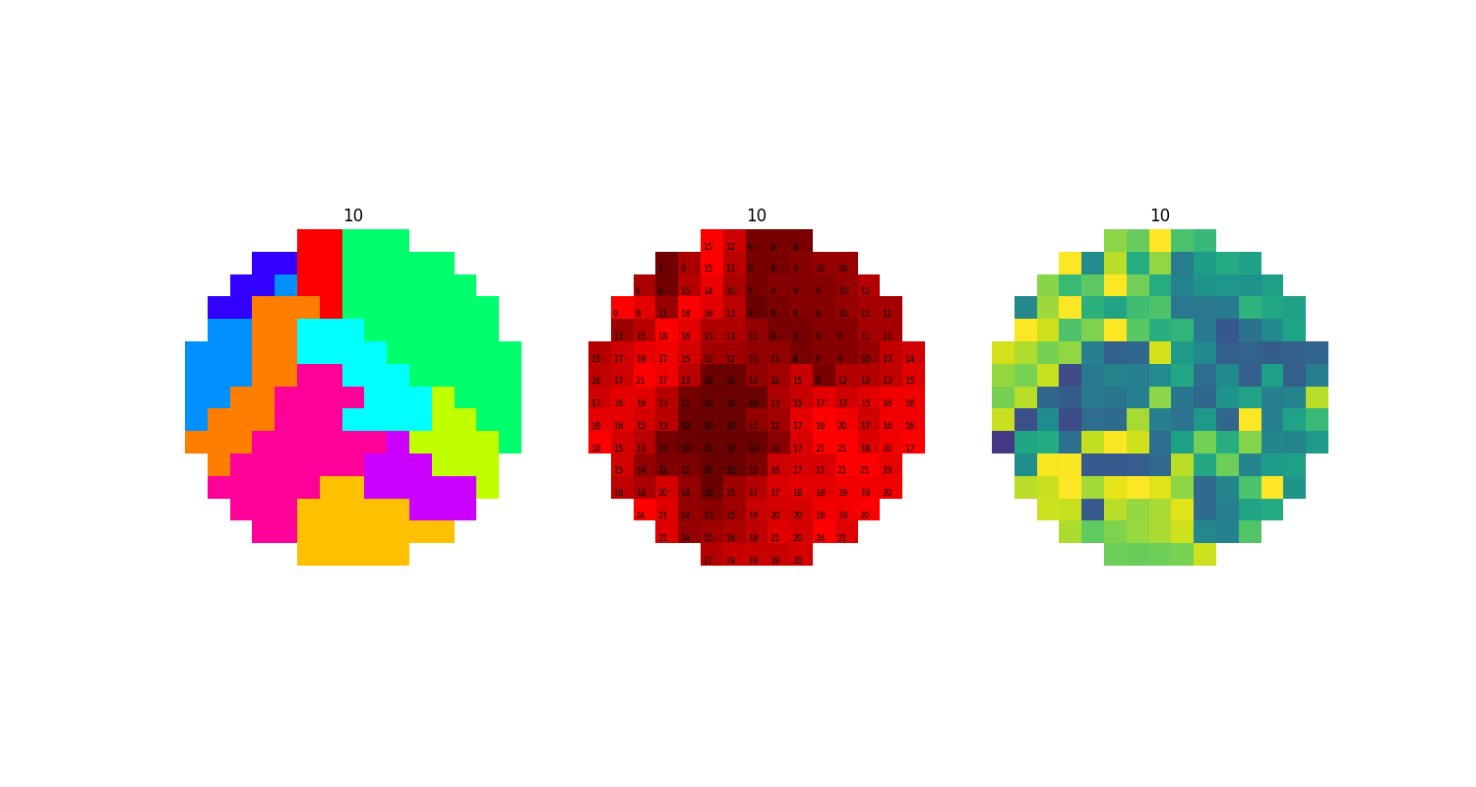
Clustering
Reduce Diffraction Patterns
Vector of unique peaks
0 if peak not present
Intensity of peak if present
Cluster based on reduced vectors

Slide 37

Further Directions
Improved Algorithm
Better blocking
Detecting peaks with computer vision
Higher dimensional peak fitting
A better algorithm…?
1
Notes:
1

